Slide 1


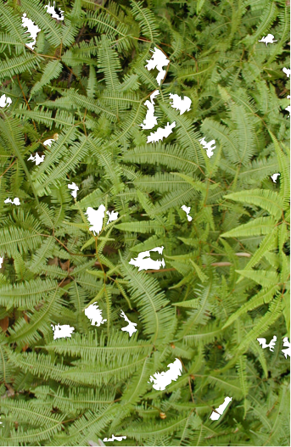
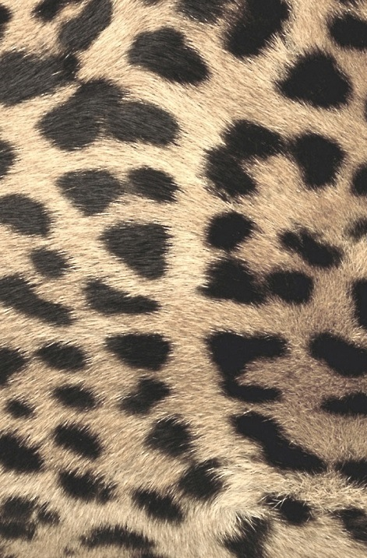

Active sensing in the categorization of visual patterns
Scott Cheng-Hsin Yang, Máté Lengyel* & Daniel Wolpert*
Department of Engineering, University of Cambridge
TexPoint fonts used in EMF.
Read the TexPoint manual before you delete this box.: AAAAAAAAAAA

Slide 2
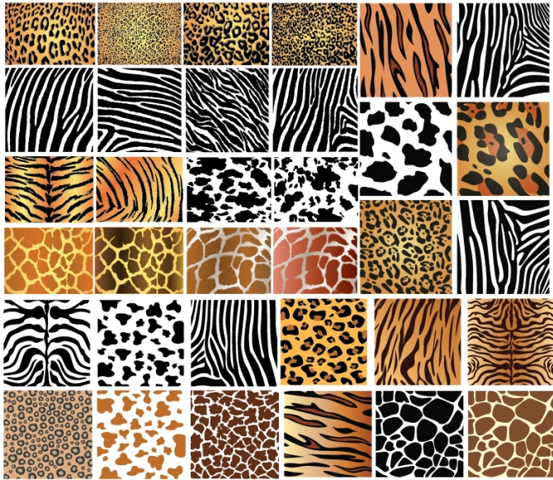

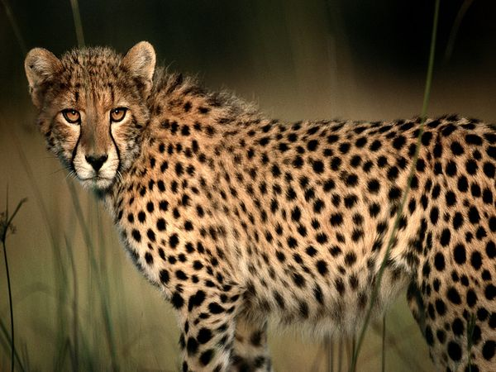

Bayesian active sensor (BAS)
Prior: statistics of different visual patterns
Evidence from previous saccades
+
P(cheetah|evidence)
P(zebra|evidence)
where to look

Slide 3
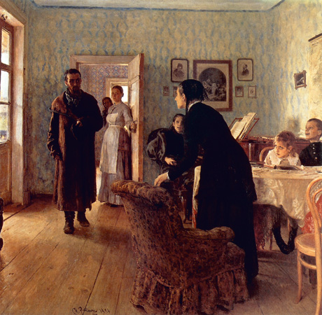
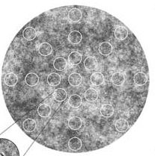

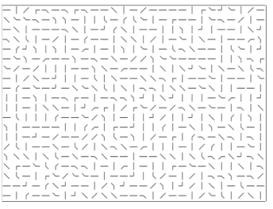
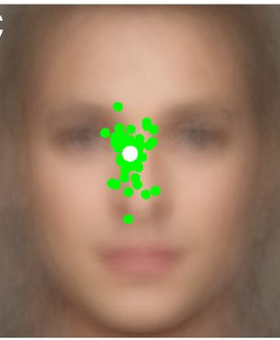
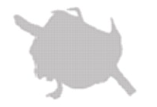
Previous work
Only spatial latent features
Single fixation
Najemnik & Geisler
Nature 2005
Morvan & Maloney
PLoS Comp. Biol. 2012
Yarbus 1967
“How long has the visitor been away from the family?”
Our approach
Task requires abstract information
Holm et al.
PLoS ONE 2012
Any single location is insufficient
Peterson & Eckstein
PNAS 2012
Foveal vision is important
Simple stimuli + gaze-contingent display
Fixation-by-fixation efficiency
Renninger et al.
J Vision 2007

Slide 4


















Experiment
Category
P
patchy
S
horizontal stripy
vertical stripy

Slide 5


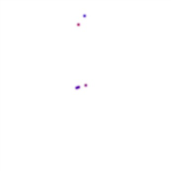
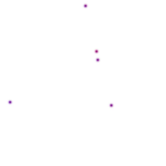

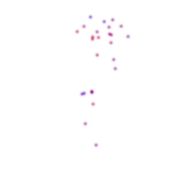
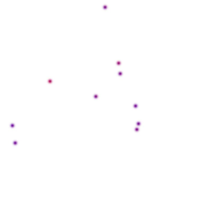
Experiment
Category
Training
Active revealing
Passive revealing
P
P S
…
…
patchy
5
ǀ
25
5
ǀ
25
S
…
…
horizontal stripy
P S
P S
vertical stripy
feedback

Slide 6
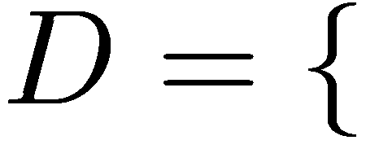

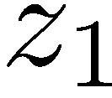

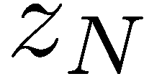


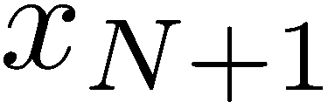
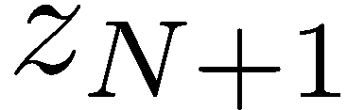


Model
probed position
perceived pixel value
observations
motor noise
perception noise
&
representation bias
Bayesian active
sensing algorithm
ideal
observer
model
infer category
predictive pixel value
possible perceived
pixel value
potential
probed position

Slide 7

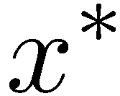
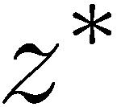

Bayesian Active Sensing algorithm
possible updated posterior probability of visual categories
posterior probability of visual categories
probed position
perceived pixel value
potential probe position
possible perceived pixel value

Slide 8
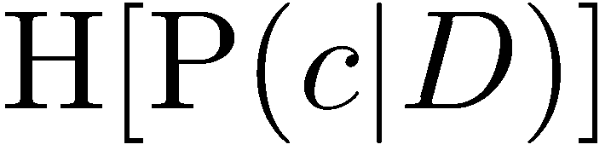

Bayesian Active Sensing algorithm
expected entropy of
possible updated posterior probability of visual categories
entropy of
posterior probability of visual categories
probed position
perceived pixel value
potential probe position
possible perceived pixel value

Slide 9


Bayesian Active Sensing algorithm
expected reduction in uncertainty (entropy) about visual category if location is probed
probed position
perceived pixel value
potential probe position
possible perceived pixel value

Slide 10

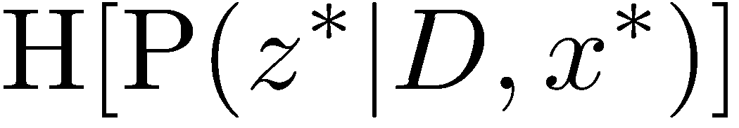

Bayesian Active Sensing algorithm
expected reduction in uncertainty (entropy) about visual category if location is probed
pixel value is overall uncertain
predicted pixel value given each category
is certain

Slide 11
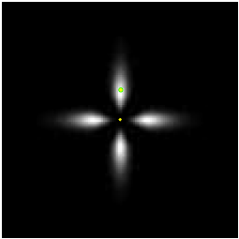
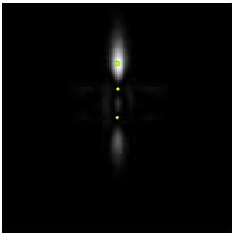
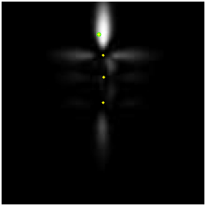
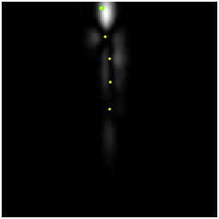
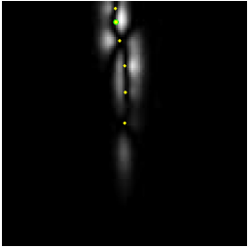
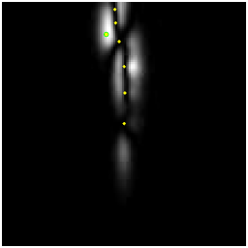
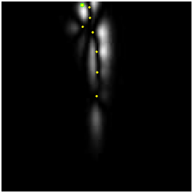
Bayesian Active Sensing algorithm
expected reduction in uncertainty (entropy) about visual category if location is probed
Qualitatively richer than inhibition of return

Slide 12





Results
patchy
horizontal stripy
vertical stripy
underlying image pattern
difference maps
0.2
mean
1
Map correlation
participant 1
participant-
self
-0.2
0
1
participant 2
0
Correlation
participant 3
-1
same
pattern
averaged
participant

Slide 13
Results
patchy
horizontal stripy
vertical stripy
underlying image pattern
difference maps
0.2
mean
1
Map correlation
participant 1
participant-
self
-0.2
0
1
participant 2
0
Correlation
participant 3
-1
same
pattern
diff
pattern
averaged
participant

Slide 14
Results
patchy
horizontal stripy
vertical stripy
underlying image pattern
difference maps
0.2
mean
1
Map correlation
participant 1
participant-
self
-0.2
0
1
participant 2
0
Correlation
participant 3
-1
same
pattern
diff
pattern
averaged
participant

Slide 15
Results
patchy
horizontal stripy
vertical stripy
Categorization performance
underlying image pattern
1
noiseless
BAS
difference maps
0.2
mean
1
active
Fraction correct
averaged
participant
passive
random
0.5
-0.2
0
0
5
10
15
20
25
Revealing number
participant-
self
1
0
Correlation
-1
same
pattern
diff
pattern

Slide 16
Results
patchy
horizontal stripy
vertical stripy
Categorization performance
underlying image pattern
1
noiseless
BAS
difference maps
0.2
mean
1
active
Fraction correct
averaged
participant
passive
random
0.5
-0.2
0
0
5
10
15
20
25
Revealing number
BAS
Information gain
1
noiseless
BAS
participant-
self
participant-
BAS
BAS
1
Information (bit)
active
passive
random
0
Correlation
0
0
5
10
15
20
25
Revealing number
-1
same
pattern
diff
pattern
same
pattern

Slide 17
Results
patchy
horizontal stripy
vertical stripy
Categorization performance
underlying image pattern
1
noiseless
BAS
difference maps
0.2
mean
1
active
Fraction correct
averaged
participant
passive
random
0.5
-0.2
0
0
5
10
15
20
25
Revealing number
BAS
Information gain
1
noiseless
BAS
participant-
self
participant-
BAS
BAS
1
Information (bit)
active
passive
random
0
Correlation
0
0
5
10
15
20
25
Revealing number
-1
same
pattern
diff
pattern
same
pattern
diff
pattern

Slide 18
Heuristics
Posterior-dependent
PA
SH
SV
Information gain
1
1
active
Information (bit)
Order-dependent
Order-dependent
Posterior-dependent
Posterior & order-dependent
0
25
0
5
10
15
20
25
Revealing number
Posterior & order-dependent

Slide 19






Summary
Integration of visual information into abstract categories
Humans are about 70% efficient in their fixation-by-fixation movement planning
A large fraction of inefficiency is due to perceptual noise, representation bias, and saccadic variability
ACKNOWLEDGEMENTS
Máté Lengyel
Daniel Wolpert
James Ingram
FUNDED BY:

Slide 20

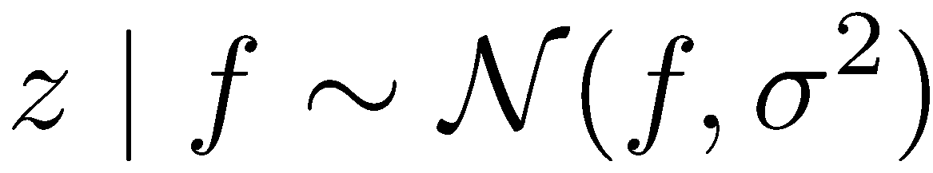
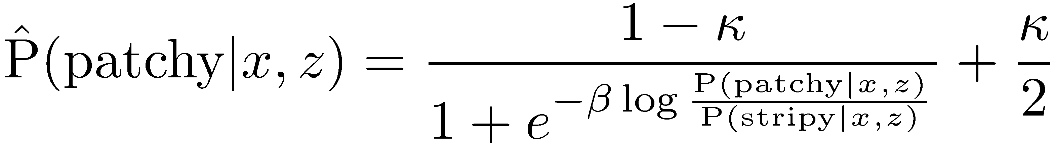
Observer model
Perception noise
Representation bias
Motor noise
displayed pixel value
Vertical length scale
perceived pixel value
Horizontal length scale
Decision rule
stimulus-independent noise
stimulus-dependent noise

Slide 21
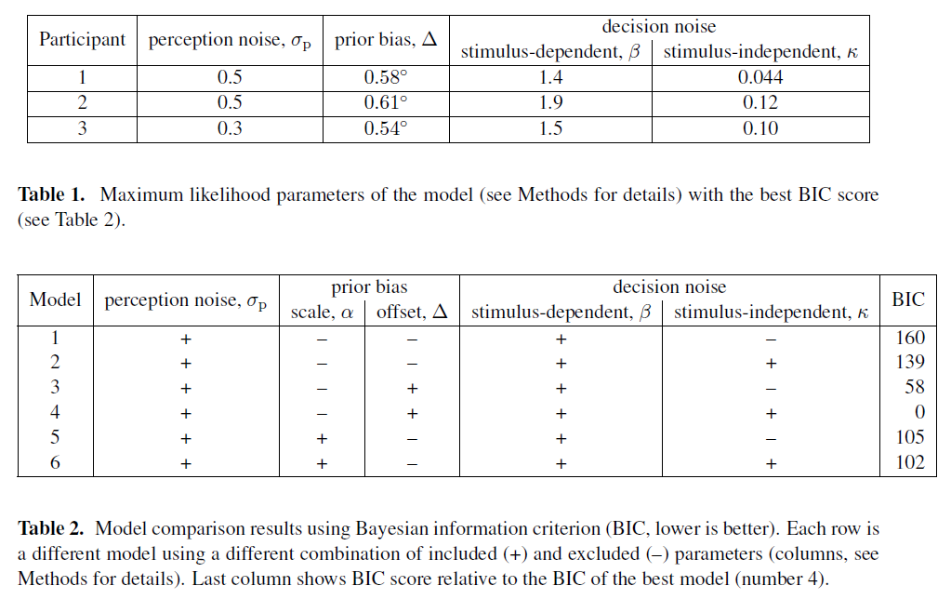

Slide 22
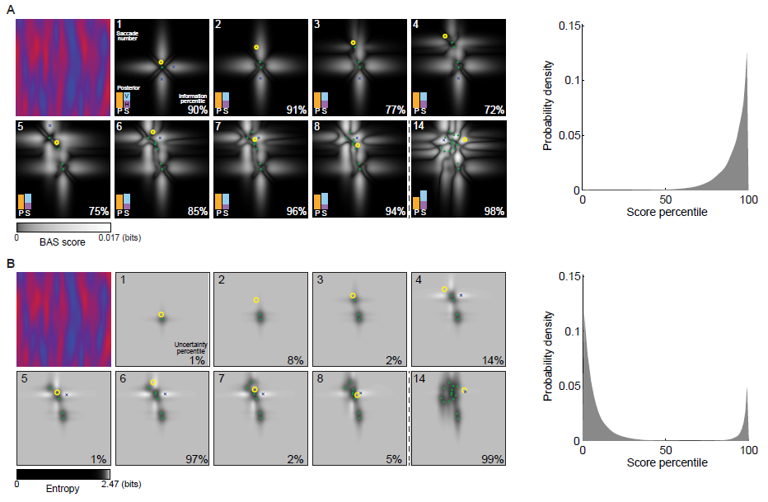

Slide 23
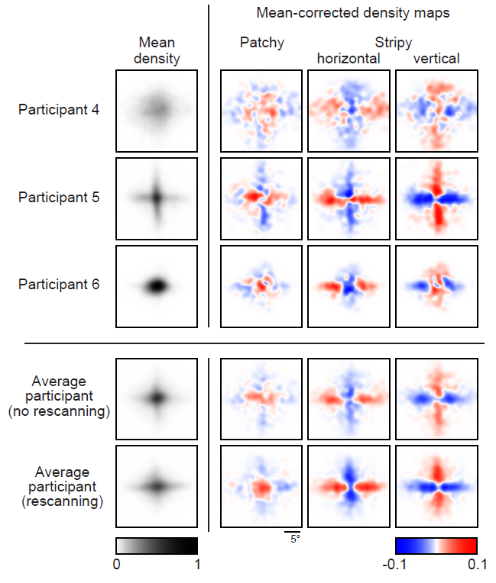

Slide 24
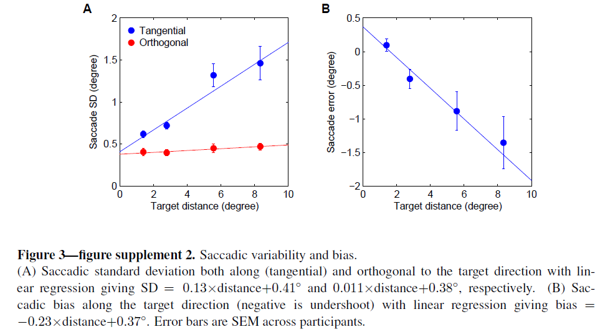

Slide 25
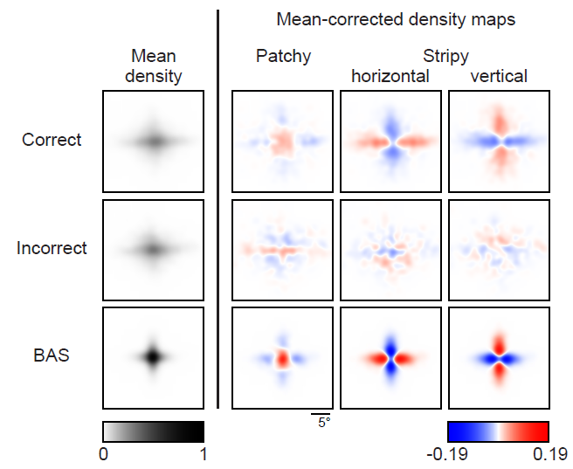

Slide 26
